Slide 1
MODULE 2: BASELINE ASSESSMENT
Session 11: Meru Lowland Wrap Up
Notes:
Meru Lowland Wrap Up

Slide 2
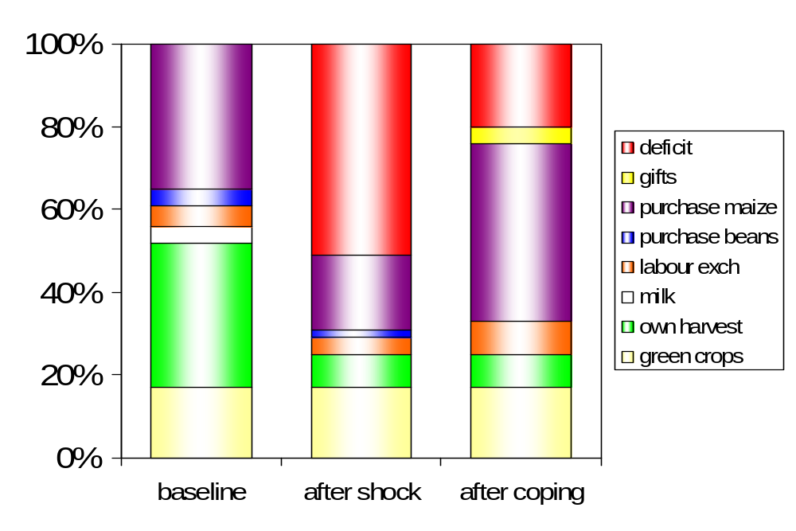
Summary
Food
% of minimum food energy requirements
Session 11: Meru Lowland Exercise

Slide 3
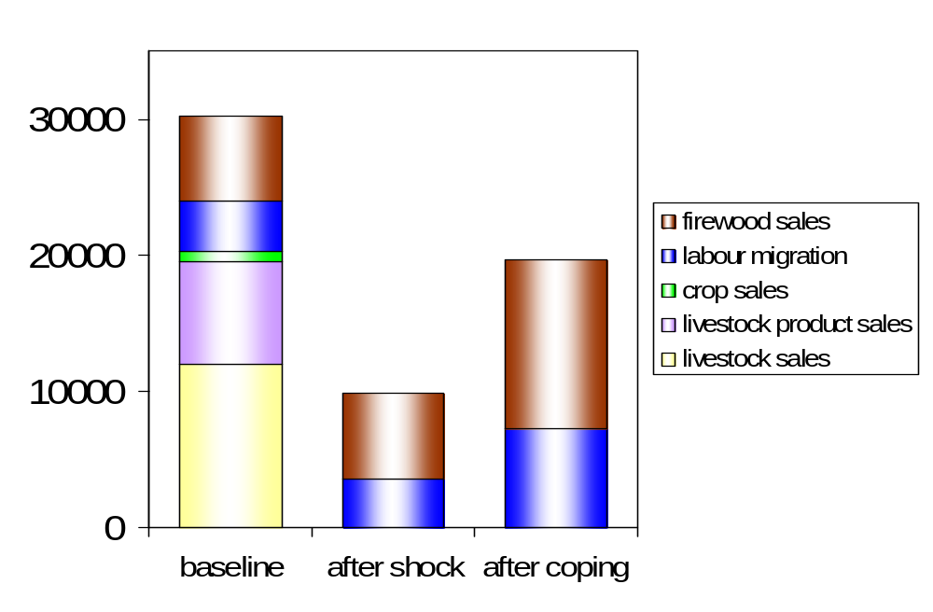
Summary
Income
K shillings
Session 11: Meru Lowland Exercise

Slide 4
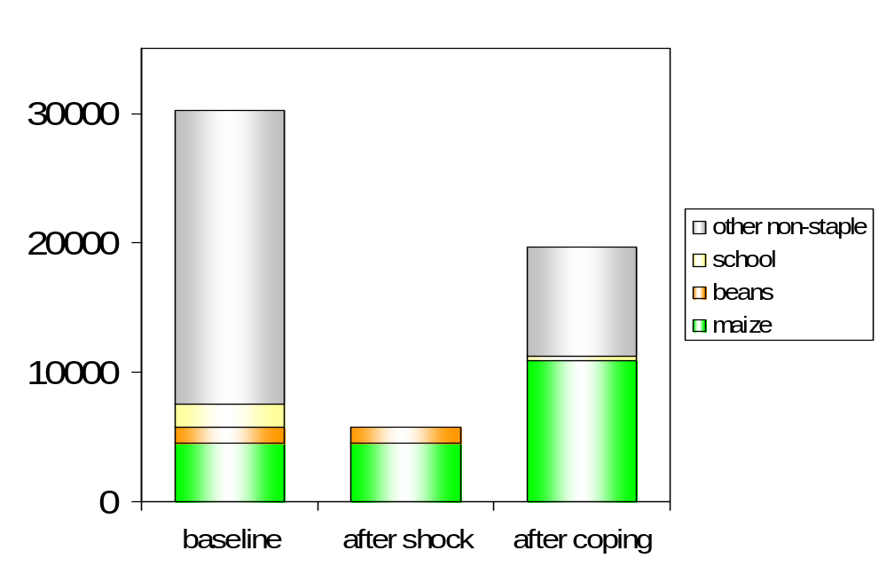
Summary
Expenditure
K shillings
Session 11: Meru Lowland Exercise

Slide 5
Objectives of this exercise
To demonstrate the three ‘pillars’ of the baseline (food, income and expenditure)
To show how things have to add up
Session 11: Meru Lowland Exercise

Slide 6
Objectives of this exercise
To actively introduce some of the cross checks and reconciling procedures used in HEA
To remind us that this quantified baseline information is being collected for a reason: to determine the effects of a hazard on households’ ability to meet their needs
Session 11: Meru Lowland Exercise

